Slide 1
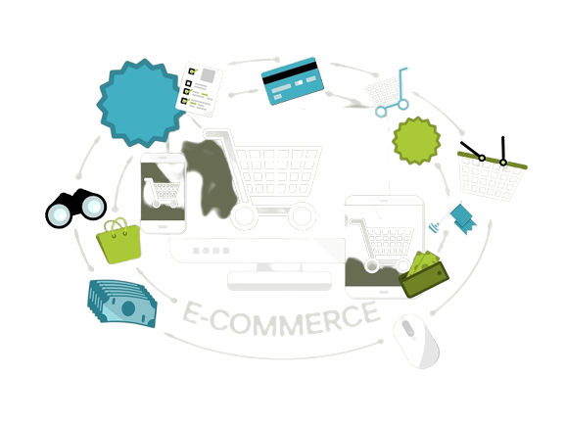
Web Development Project
E-Commerce Site E-Trades
Developed By Adarsh Tamang
^{BCA 1st Semester}
DivyaGyanCollege

Slide 2
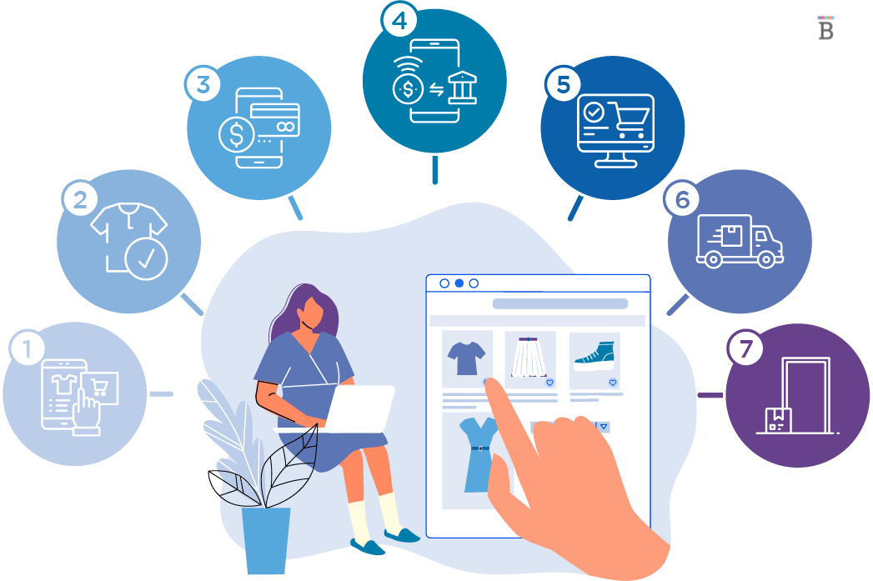
Introduction
What is E-commerce ?
E-commerce refers to the buying and selling of goods and services over the internet, with the help of websites and online marketplaces.
E-commerce has revolutionized traditional retail by offering consumers more convenience, greater selection, and lower prices.
The transaction is processed online, and the purchased goods or services are either delivered physically to the customer or provided electronically.

Slide 3


Technology Used
JAVASCRIPT
HTML
CSS
Tools
VS CODE

Slide 4
Figma Design Of Website

Slide 5
Objective Of Project
To increase sales and revenue for the business.
To reach a wider audience and sell more products or services throw E-commerce.
To expand their reach beyond their local market and reach customers from all over the world.
To provide customers with a seamless and convenient shopping experience, making it easier for purchase.
To automate many aspects of the sales process, including inventory management, order fulfillment, and payment processing whice save time and reduce costs for the business.
To building brand awareness and establishing a business's online presence. By offering valuable information and high-quality products.
To collect valuable data about customer behavior, such as their purchase history, search patterns, and online habits . Whice can be used to improve the customer experience and make business decisions.
To makes it easier for customers to access products and services, even if they are not able to physically visit a store.
To reducing the need for physical retail space, e-commerce websites can help businesses save money on rent, utilities, and other overhead costs.
To automate many manual processes, reducing the need for manual labor and cutting costs.

Slide 6
Future Enhancement
The future of e-commerce is rapidly evolving, and new technologies are being developed to enhance the online shopping experience. Some potential future enhancements for e-commerce websites include:
AI and ML algorithms can be used to personalize the shopping experience for customers by recommending products based on their browsing history and purchase history.
VR technologies can be used to create immersive shopping experiences, allowing customers to try on clothes or see how furniture would look in their homes.
Chatbots and voice assistants can be used to provide 24hrs customer support and improve the overall shopping experience.
The advent of 5G networks and edge computing can provide faster and more reliable online shopping experiences.
Blockchain technology can be used to improve the security and transparency of e-commerce transactions.
Social commerce refers to the integration of social media and e-commerce, making it possible for customers to make purchases directly from social media platforms.

Slide 7
Conclusion
In conclusion, an e-commerce website is a crucial platform for businesses looking to reach a wider audience and expand their sales. It provides customers with a convenient and accessible shopping experience, allowing them to browse and purchase products or services from the comfort of their own homes. To be successful, an e-commerce website must have a user-friendly design, offer a wide range of products, provide secure payment options, and have effective marketing strategies in place to drive traffic and increase conversions. Additionally, it is important to constantly evaluate and improve the site to ensure it meets the changing needs of customers and remains competitive in a rapidly evolving digital market.

Slide 8
Thank you

